Slide 1
The keksec botnets we observed in the past year
Ye Jin, Qihoo 360
Lingming Tu, Qihoo 360

Slide 2
Outline
Background
Campaigns
Exploits
Malware analysis
Operations

Slide 3
Background

Slide 4
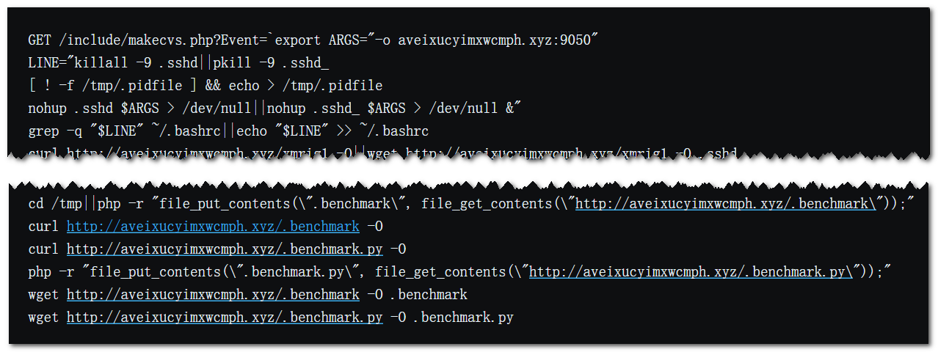
Start with Necro

Slide 5
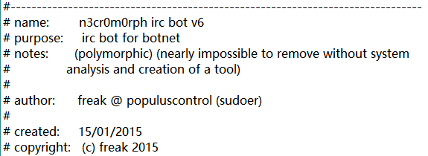
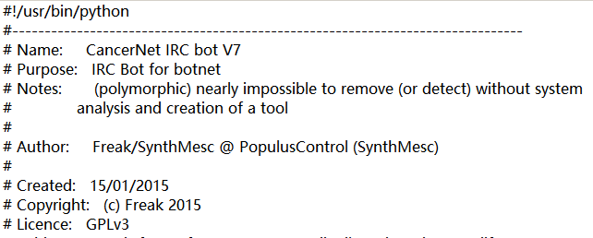
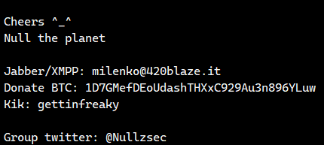
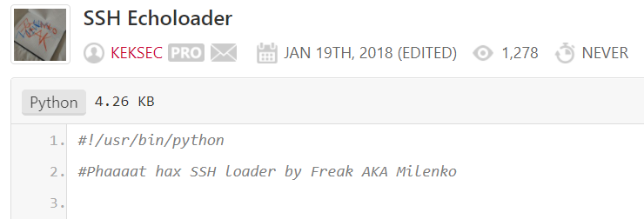
Mr. Freak’s pastebin
https://pastebin.com/u/KekSec
2014 | 2016 | 2020~now
Salamander Fl0urite | PopulusControl SynthMesc Sudoer Nullzsec Milenko | KekSec

Slide 6
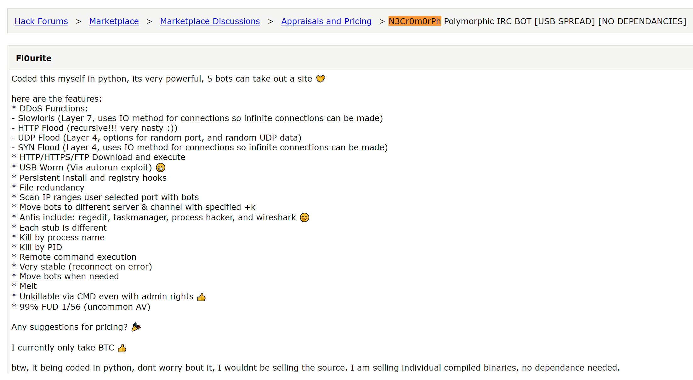
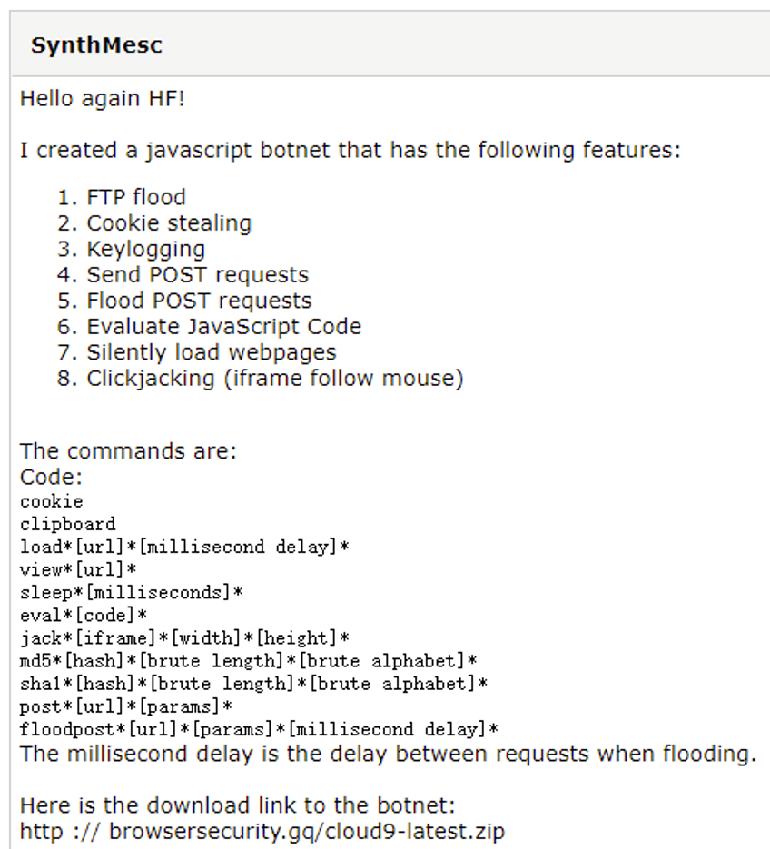
Mr. Freak’s business

Slide 7
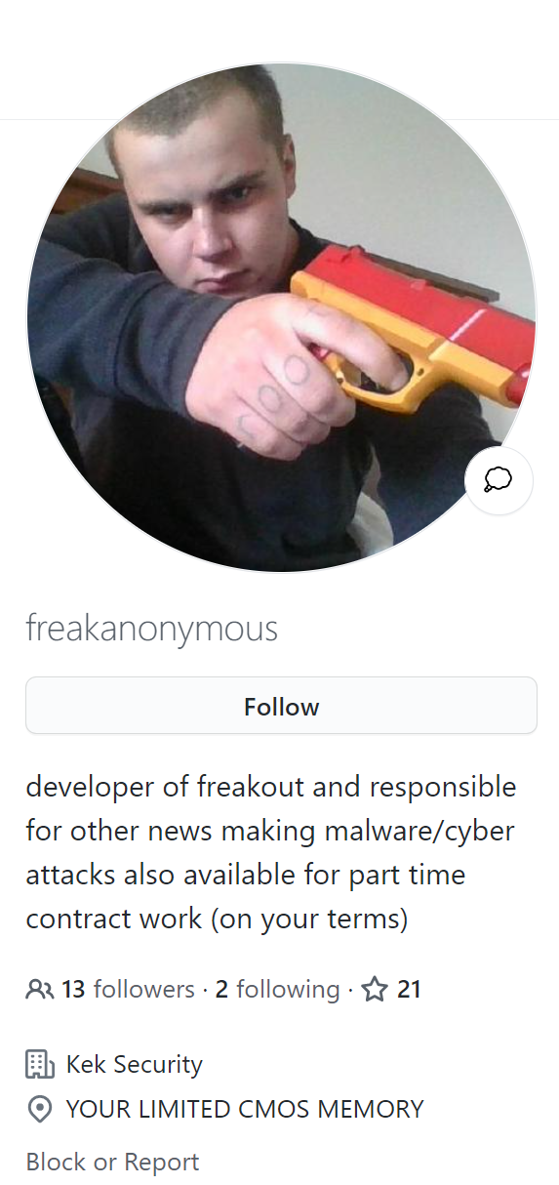
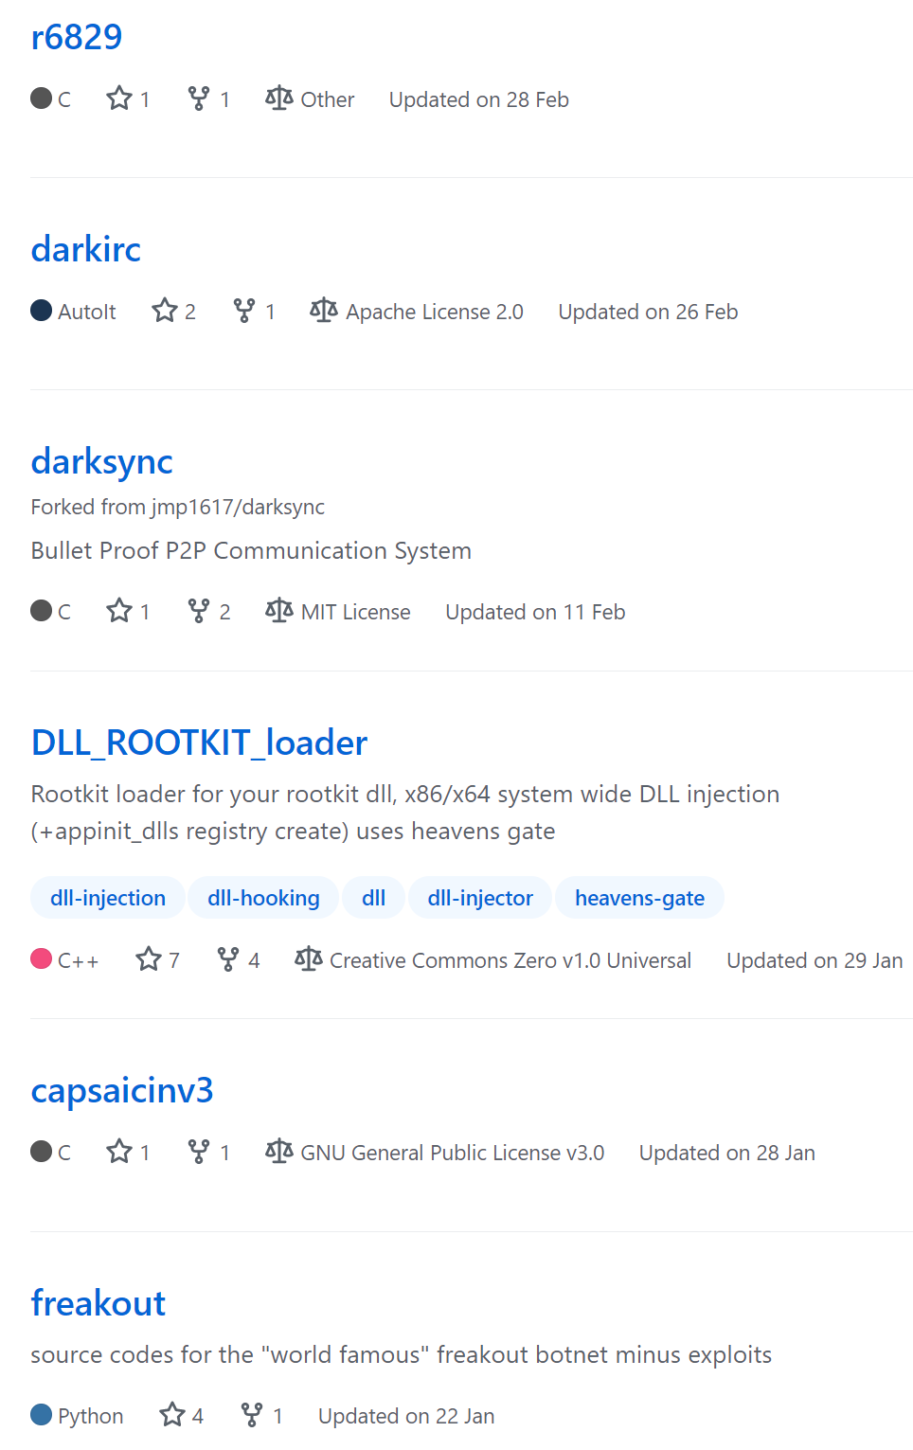
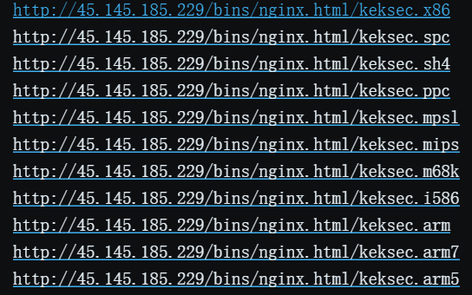
Who is KekSec

Slide 8
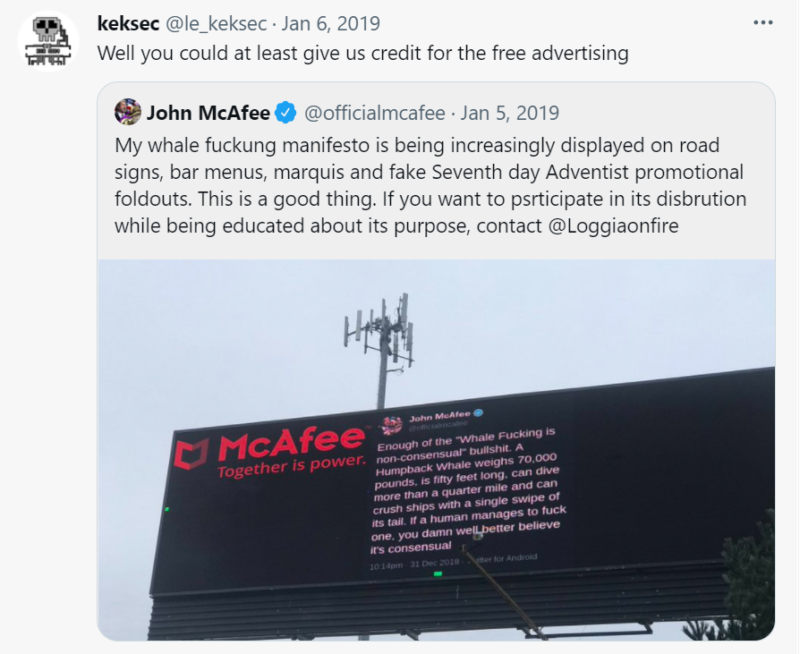
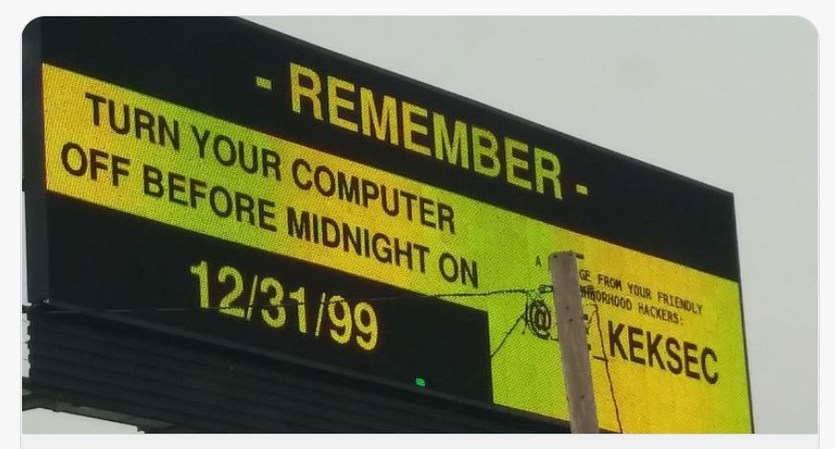
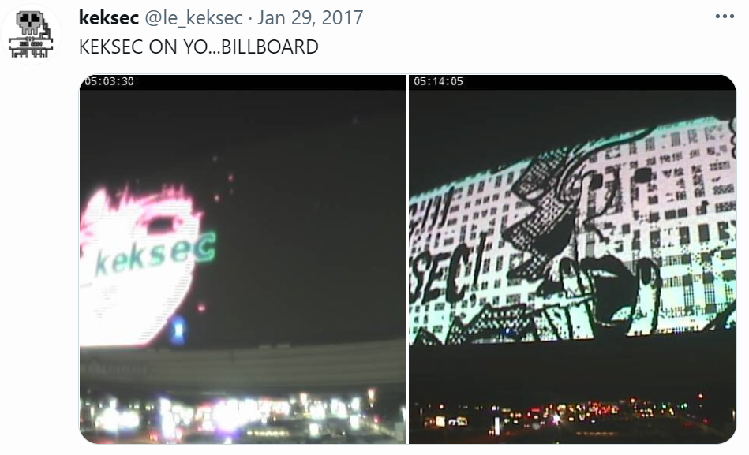
Attacking billboard

Slide 9
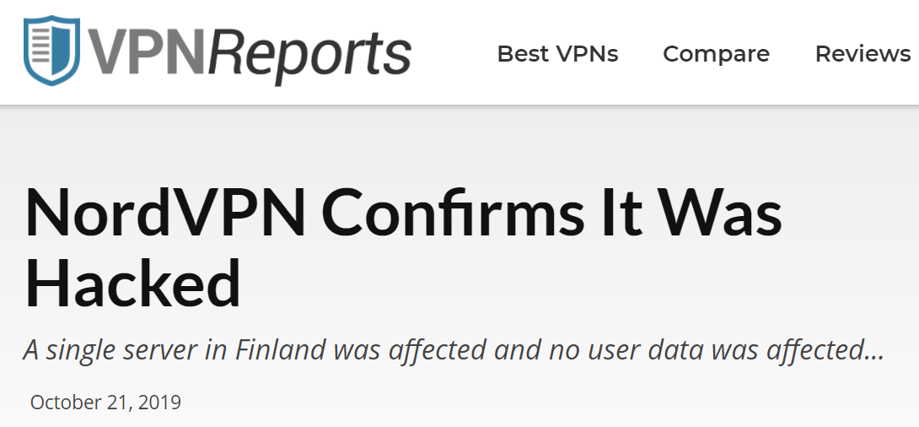
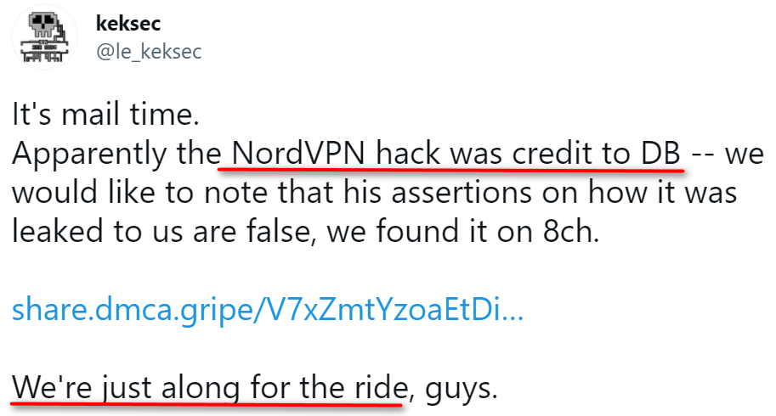
Attacking NordVPN
Fake News!

Slide 10
Campaigns

Slide 11
What we have done?
Summarize yara rules by analyzing the hunted samples
Scan sample database
Group and cluster all sample
Remove false positive
Extend sample set through TI system
23 exploits
5564 samples
3 malware families (ignoring variant classification)

Slide 12
Attack stats
Before 2020/12
From 2021/1

Slide 13
Exploits

Slide 14
Exploit stats
 | First seen | Exploit(CVE) | Exposure time | Target Device/SoftWare | Family
1 | 2020.8.26 |  |  | Realtek | Tsunami
2 | 2020.9.3 |  |  | Realtek | Gafgyt
3 | 2020.9.20 |  |  | Huawei_Router | Gafgyt
4 | 2020.9.25 |  |  | Avtech_Camera_RCE | Gafgyt
5 | 2020.10.21 |  |  | ThinkPHP_RCE | Gafgyt
6 | 2020.11.2 |  |  | JAWS_DVR_RCE | Gafgyt
7 | 2020.11.11 |  |  | ZTE_Router_RCE | Gafgyt
8 | 2020.11.19 |  |  | yarn_api | Gafgyt
9 | 2020.11.19 |  |  | Avtech_IP_Camera_ACI | Gafgyt
10 | 2020.11.24 |  |  | Zyxel_VIEWLOG_RCE | Gafgyt
11 | 2020.11.26 |  |  | ZeroShell_Kerbynet_RCE | Gafgyt
12 | 2021.1.8 | CVE-2020-7961 | 2020.7 | Liferay Portal | Necro
13 | 2021.1.8 | CVE-2020-35665 | 2020.12.23 | TerraMaster | Necro
14 | 2021.1.8 | CVE-2021-3007 | 2021.1.3 | Zend Framework | Necro
15 | 2021.3.10 |  |  | WebLogic RCE | Necro
16 | 2021.3.20 | CVE-2021-21972 | 2021.2.27 | VMware_vCenterServer | Necro
17 | 2021.3.23 |  |  | SonicWALL_XMLRPC_settimeconfig_RCE | Gafgyt
18 | 2021.4.26 |  |  | F5_iControl_mgmt_RCE | Gafgyt
19 | 2021.5.1 |  |  | VestaCP | Necro
20 | 2021.5.1 |  |  | SCO Openserver | Necro
21 | 2021.5.1 |  |  | Genexis PLATINUM | Necro
22 | 2021.5.1 |  |  | OTRS 6.0.1 | Necro
23 | 2021.5.1 |  |  | Unknown (Nrdh.php) | Necro

Slide 15
Malware analysis

Slide 16
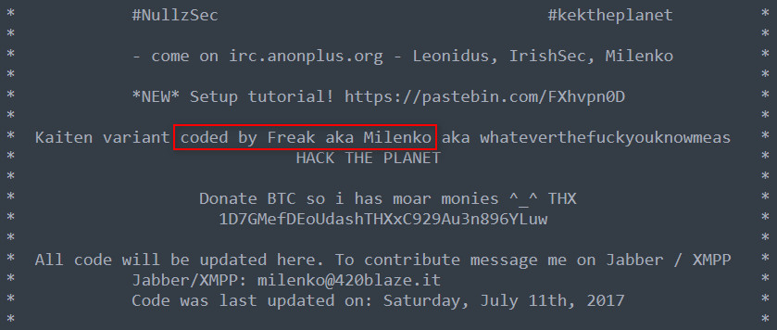
Families
Linux based: Tsunami(Capsaicin, Ziggy), Gafgyt (LULzbOT, Oreo, Gafgyt_tor)
Windows based: DarkIRC (AutoIt packed), DarkHTTP (AutoIt packed)
Developed in Python to target dual systems: Necro
Developed in JavaScript to target Browser: Cloud9
From open-sourced projects: Rootkit, Miner

Slide 17
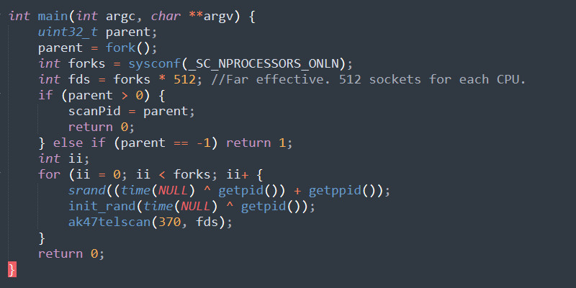
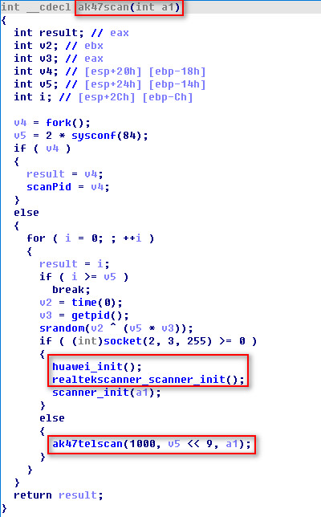
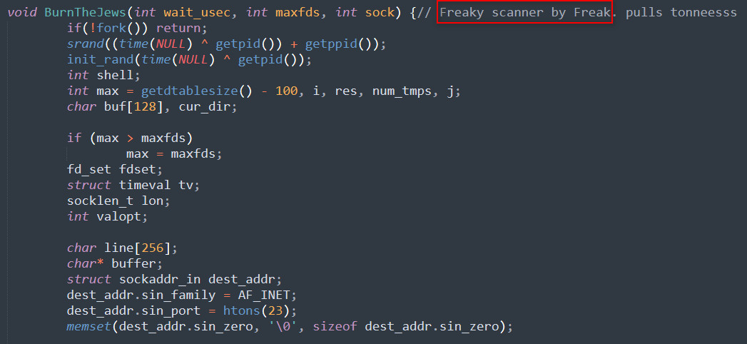
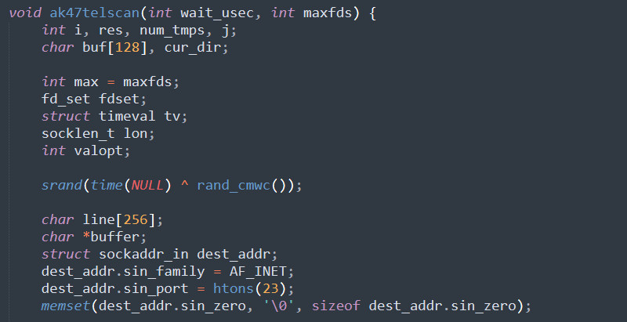
Scanner - telnet

Slide 18
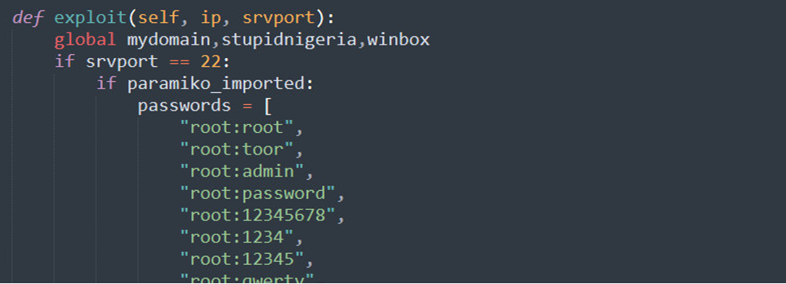
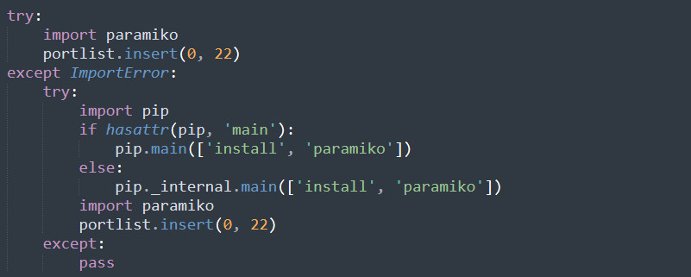
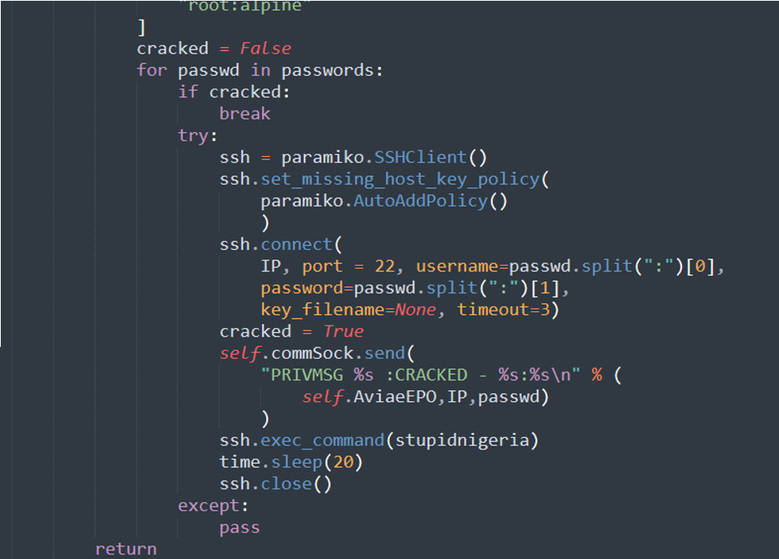
Scanner - ssh
Only Necro supports SSH scan

Slide 19
Scanner - exploit
TerraMaster RCE - CVE-2020-28188
VMware vCenter Serve RCE - CVE-2021-21972
WebLogic RCE (CVE-2020-14882)

Slide 20
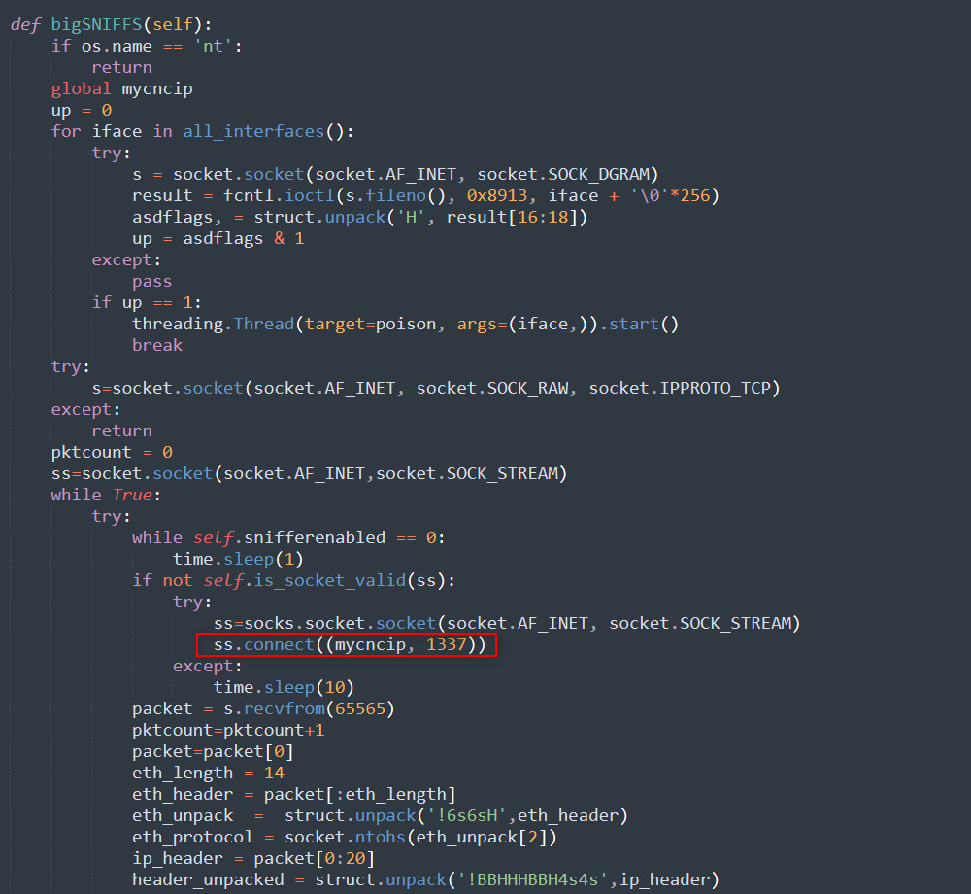
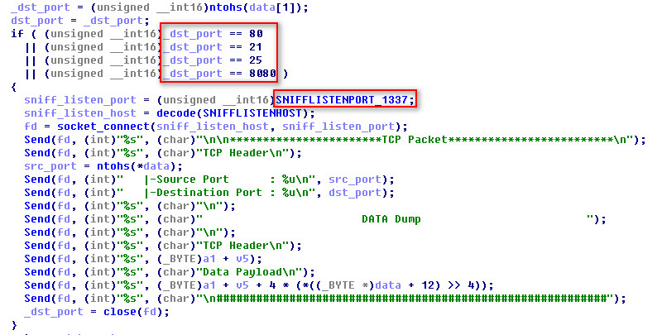
Sniffer
Check ports to sniff

Slide 21
Disguiser process
Change process name
Use rootkit hide process

Slide 22
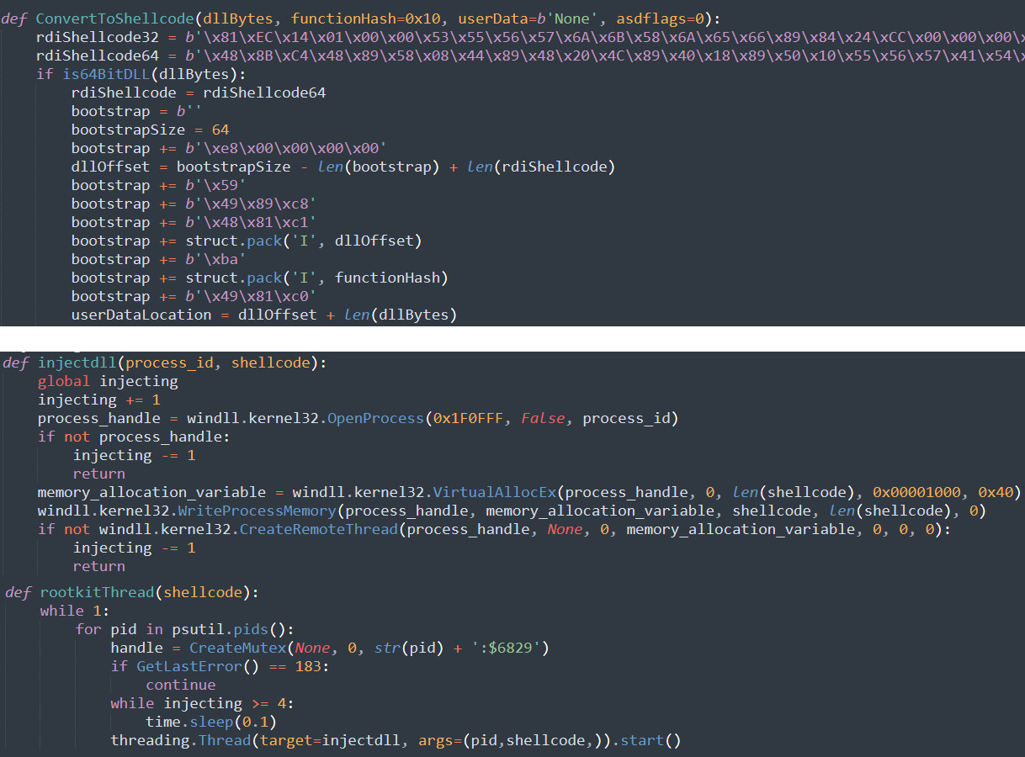
Process injection
Based on GitHub open-source project RDI
Uses process injection to load the rootkit

Slide 23
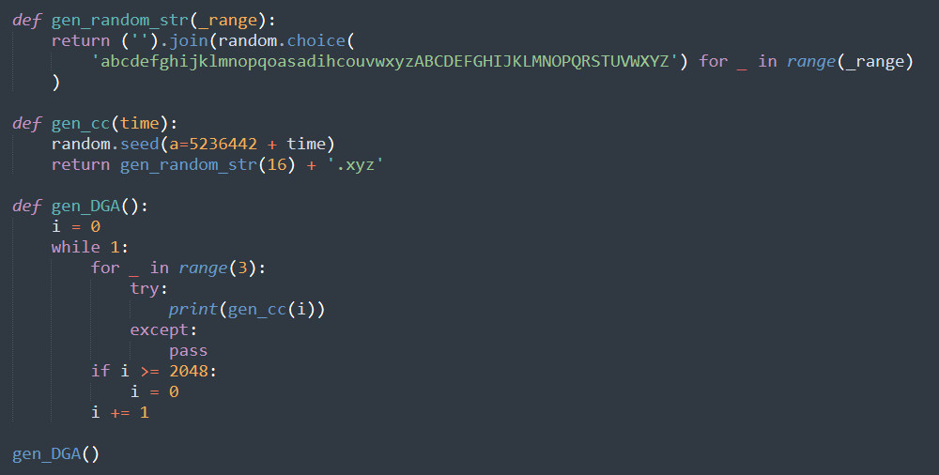
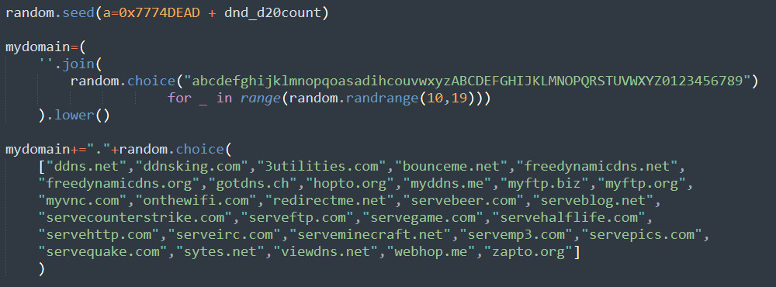
DGA
Random string + “.xyz".
Random string + DDNS

Slide 24
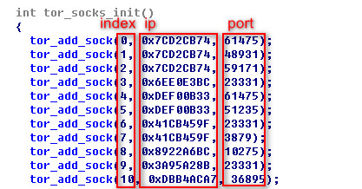
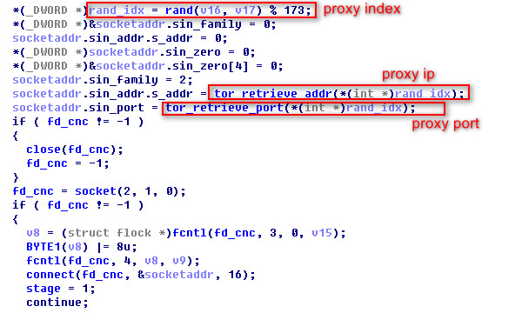
Tor - Gafgyt
Tor proxy is used to talk to C2
Randomly selecting one from the list
Connection to onion C2 will be established

Slide 25
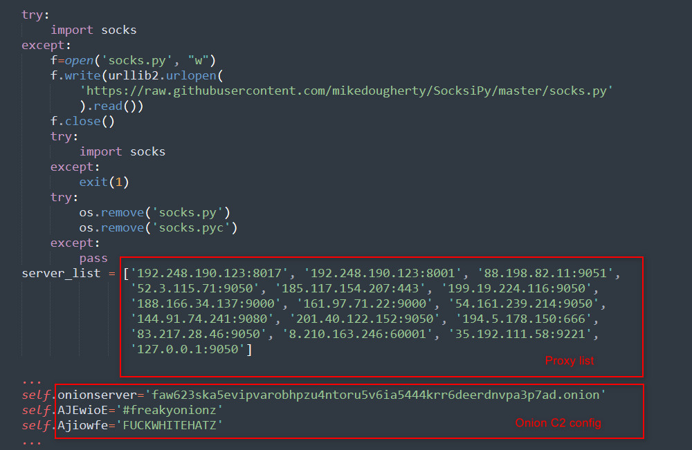
Tor - Necro

Slide 26
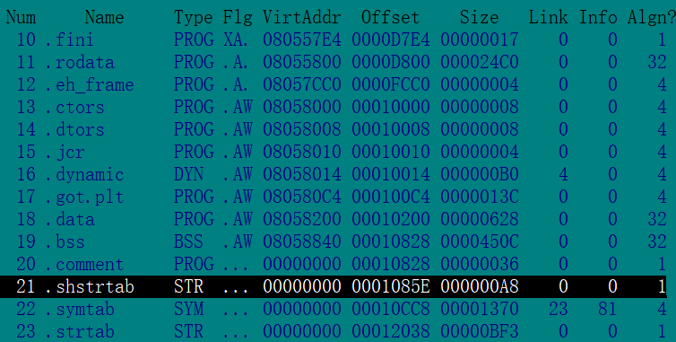
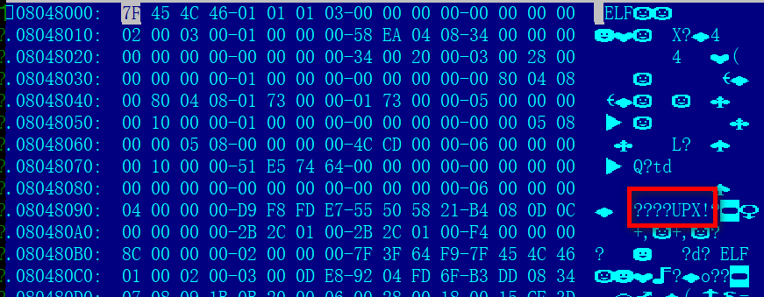
Packer - UPX
Most of the Gafgyt and Tsunami samples are not packed and not stripped.
A few of the packed samples use the standard UPX shell, which can be directly removed with open source tools.

Slide 27
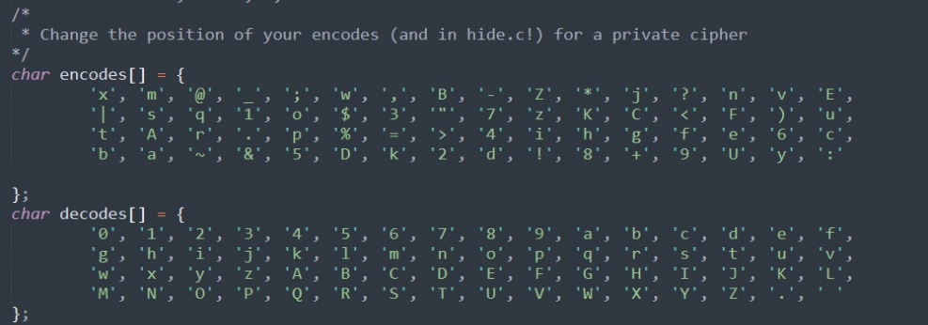
Obfuscation
Gafgyt and Tsunami encrypt sensitive strings with a simple mapping algorithm
Necro protects the string by character substitution and zip compression.
'%q*KC)&F98fsr2to4b3yi_:wB>z=;k? “EAZ7.D-md<ex5U~h,j|$v6c1ga+p@un0'

Slide 28
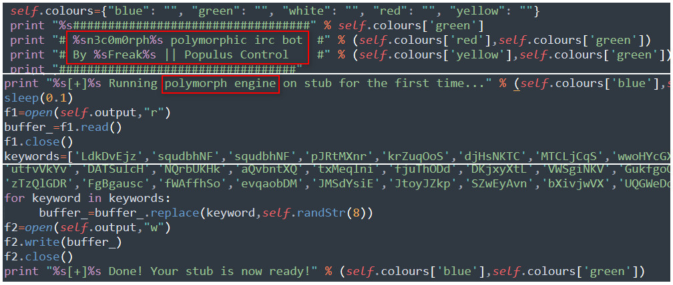
Polymorphic python
The old version uses a random string to replace a predefined key object names.

Slide 29
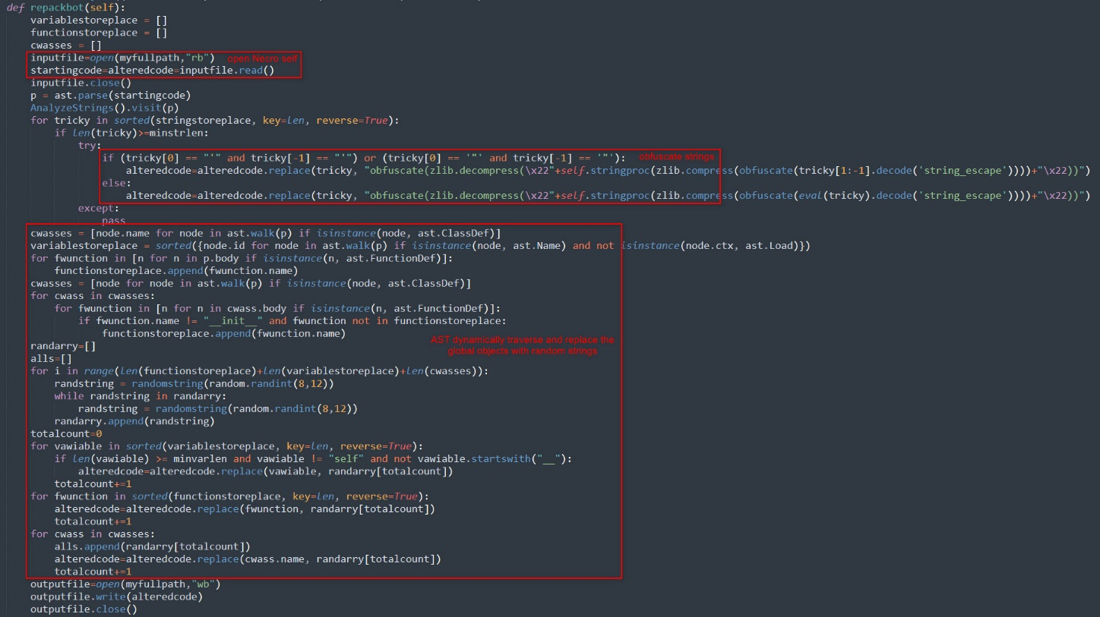
Polymorphic python
The new version uses python's AST library to dynamically traverse and replace the global objects with random strings.

Slide 30
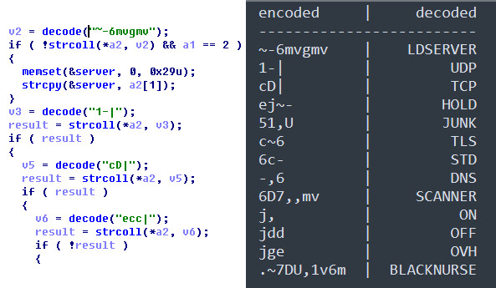
C2 Protocol - Gafgyt
Decode CMD before
parse received data
Decoded
Gafgyt CMD

Slide 31
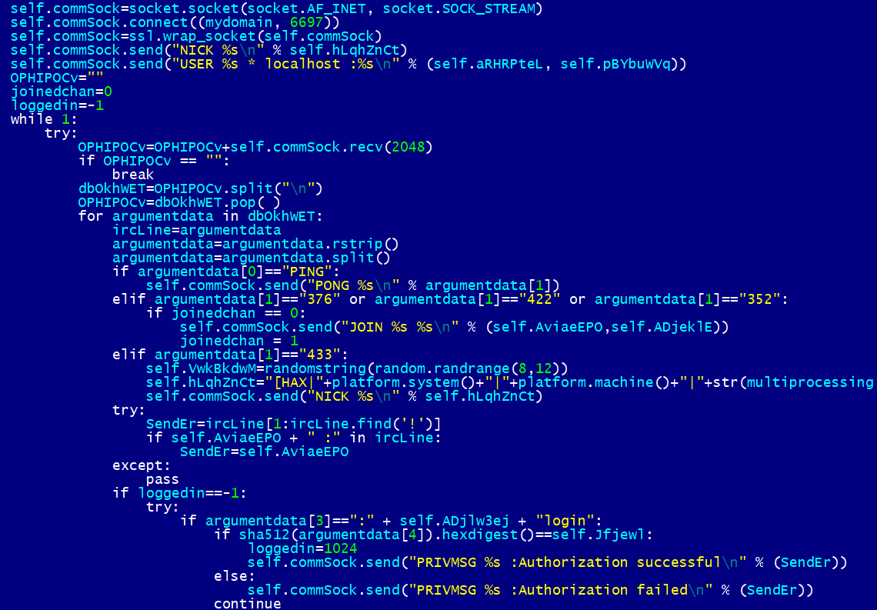
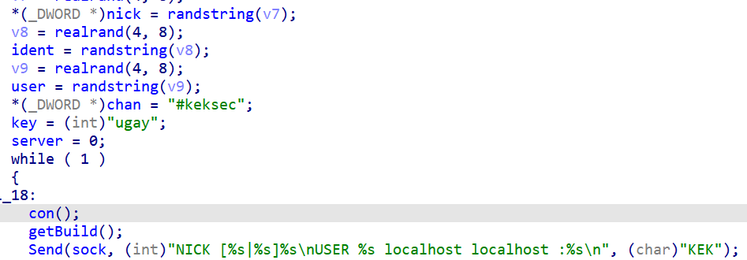
C2 Protocol - IRC
Tsunami Login IRC server
Necro Login IRC server
Because the protocol is compatible, they can share the same c2 server.

Slide 32
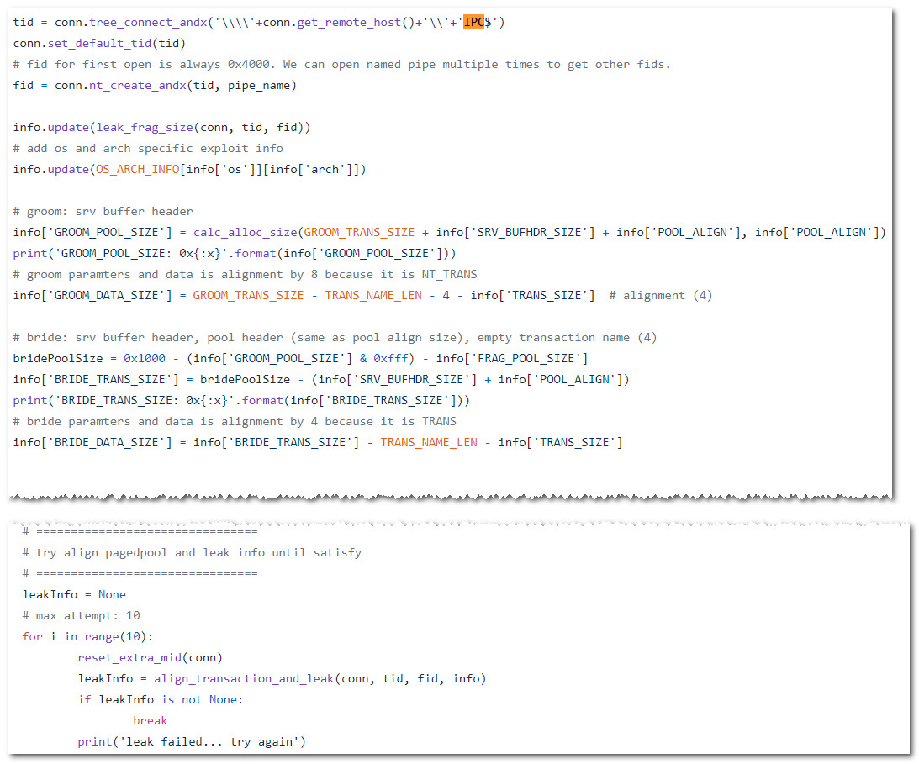
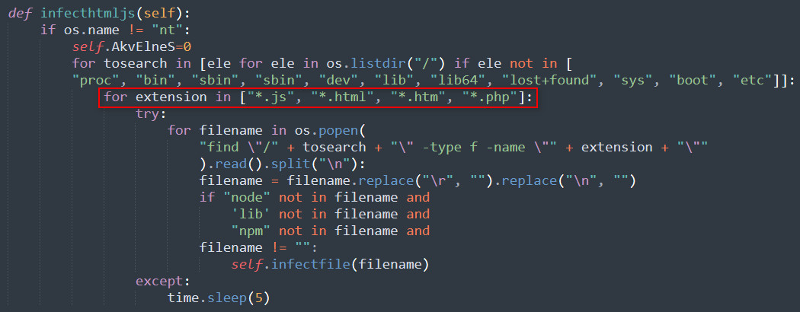
Spreading
Exploit/SSH/Telnet (internet)
Infection Page (virus-like)
SMB (intranet)

Slide 33
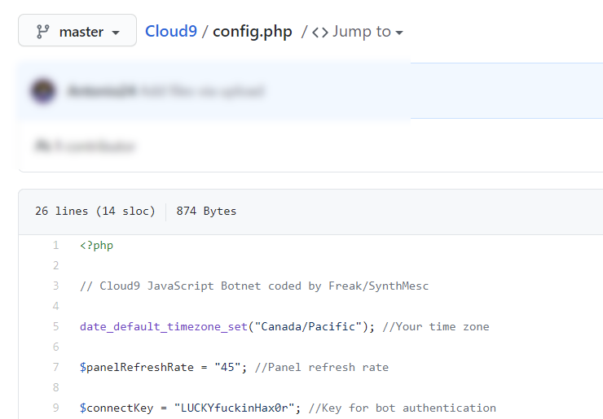
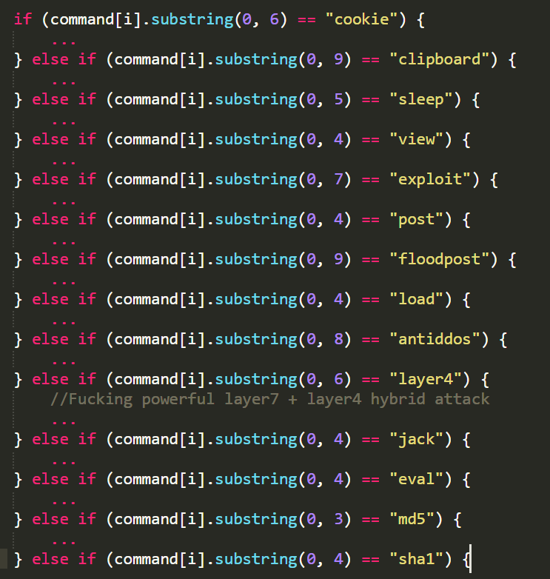
JS Bot - Cloud9
Steal: clipboard, cookie
Hijack: page, view, load, jack
DDoS: layer7+layer4, floodpost
Hash calc: md5, sha1
Local exploit: exploit
Dynamic load: eval

Slide 34
Miner
XMR - Monero coin
XTZ - Tezos coin

Slide 35
Feature summary
Feature\FN | Necro | Tsunami | Gafgyt
IRC | * | *
Tor | * |  | *
String encode | * | * | *
Polymorphic | *
UPX |  | * | *
Not stripped |  | * | *
DGA | *
DGA+DDNS | *
Sniffer | * | * | *
Ak47Scan | * | * | *
Telnet scan |  | * | *
SSH scan | *
Exploit scan | * | * | *
SMB scan | *
Necro has the most comprehensive functions and features
In order to cover low-power devices Tsunami and Gafgyt were developped
All malwares support sniffer
One single IRC C2 system can be used to control multiple families

Slide 36
Operations

Slide 37
Necro delivery
Stage 1
Stage 2
Stage 3

Slide 38
Necro C2 migration
C2 A
C2 A: can6dodp.servepics.com
C2 B: bp65pce2vsk7wpvy2fyehel25ovw4v7nve3lknwzta7gtiuy6jm7l4yd.onion.ws
C2 C: download.service-exec.net
C2 B
The historical request volume has exceeded 500,000
Based on 3rd part data, requests per day should be around 100,000.
C2 C

Slide 39
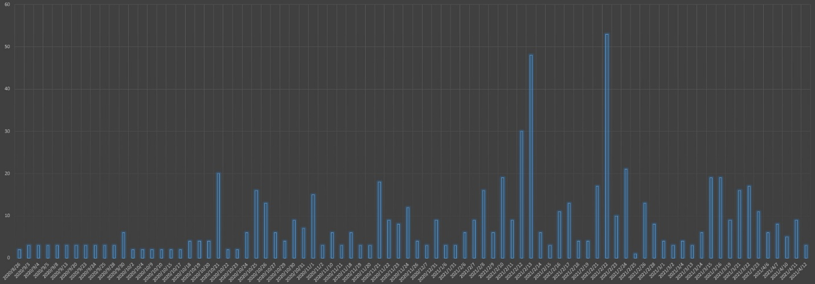
Tsunami&Gafgyt delivery
This indicates that the Keksec group has sufficient manpower and resources and is becoming increasingly active.
2020/8
2021/1

Slide 40
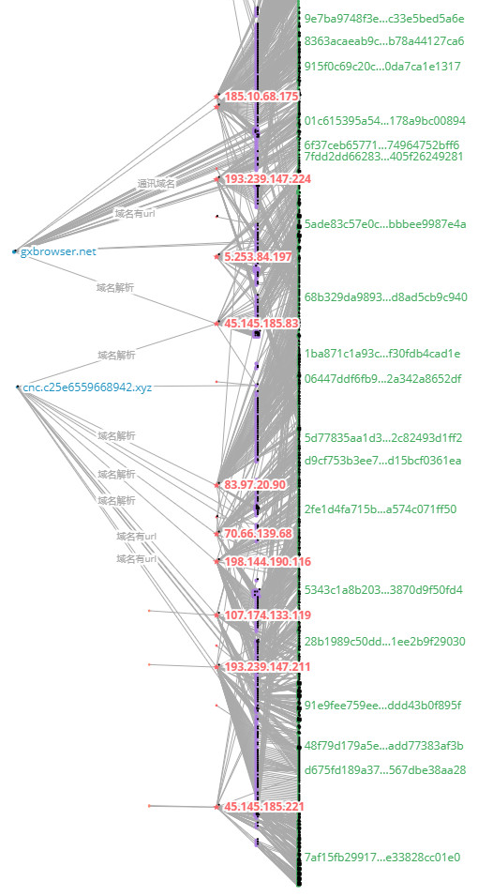
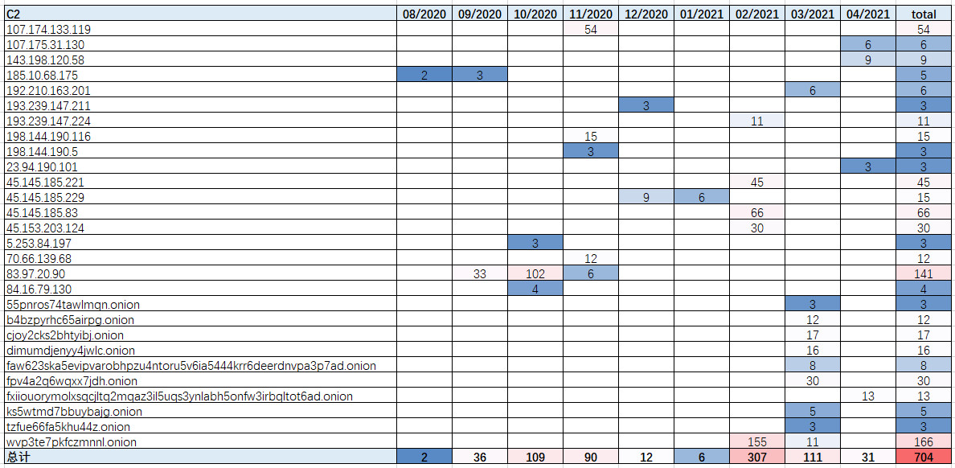
Tsunami&Gafgyt infrastructure
C2 IP lifecycle varies from 1 month to 3 months.
The preference is to use IP resources in the same network segment within the same cycle.
The deployment of C2s used domain names and IPs until March 2021, and then shifted to using Tor proxies from March onwards.

Slide 41
Family reuse statistic
The Tsunami sample appeared in mid-August 2020 and was active for a short period of time.
The Gafgyt sample was active intermittently from September to December 2020.
A malicious family named Necro suddenly appeared in January.
From early to mid-February, first the Tsunami sample resumed propagation, then Gafgyt, followed by Gafgyt_tor.
There are many similarities between the Gafgyt_tor variant and the previously captured Gafgyt sample, with code that is clearly homologous.

Slide 42
Conclusions

Slide 43
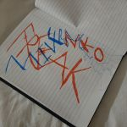
Conclusions
We have always been tracking Freak's KekSec
Their scanning almost never stop
There is no 0day, but utilization of 1day is very fast
It has strong code integration and bot operations capabilities
A very organized and productive and aggressive group

Slide 44
Thank you~
jinye@360.cn
tulingming@360.cn

