Slide 1
Dancing samba with dolphins: Tracking a Brazilian threat actor moving to Europe
September 2020

Slide 2
Agenda
Samba Dolphins are coming…
Rooty Dolphin
Mekotio
Tactics, Techniques and Procedures (TTPs)
Chilean Campaign
Spanish Campaign
Italian Campaign
Links between campaigns
Conclusion

Slide 3
Samba Dolphins are coming…
Typically Brazilian actors target South American countries
Brazilian Malware != Russian Malware
Window Monitoring vs Man in the Browser / API Hooking
Delphi as chosen malware programming language
Since some months ago Dolphin campaigns in Europe
Grandoreiro in Portugal, Germany, Spain…
Mekotio in Portugal, Spain, Italy…
They are coming!!

Slide 4
Rooty Dolphin
Likely Brazilian origin
Targets banks in Europe and South America using Mekotio
Brazil, Chile, Spain, Italy…
root@malicious_domain_performing_spoofing = Rooty
Mekotio is written in Delphi = Dolphin
Tracking of campaigns thanks to:
Email
Control panel (Dropper)
Mekotio samples

Slide 5
Mekotio
Banking trojan with Brazilian origin.
Campaigns against Latin American banks, especially in Chile.
The protocol used similar to a Delphi Remote Access project.
https://github.com/Maickonn/Delphi_Remote_Access_PC

Slide 6
Mekotio
Encrypted strings
Hardcoded configuration
Use of Google Docs to update the C2
Clipboard BTC hijacking
Custom protocol using port 8350 (usually)
Requires an operator to perform banking fraud

Slide 7
Mekotio
bankLocalHost.com
Tab Title: bank LocalHost
Operator
Mekotio
Custom protocol
Enumeration

Slide 8
Rooty Dolphin TTPs

Slide 9
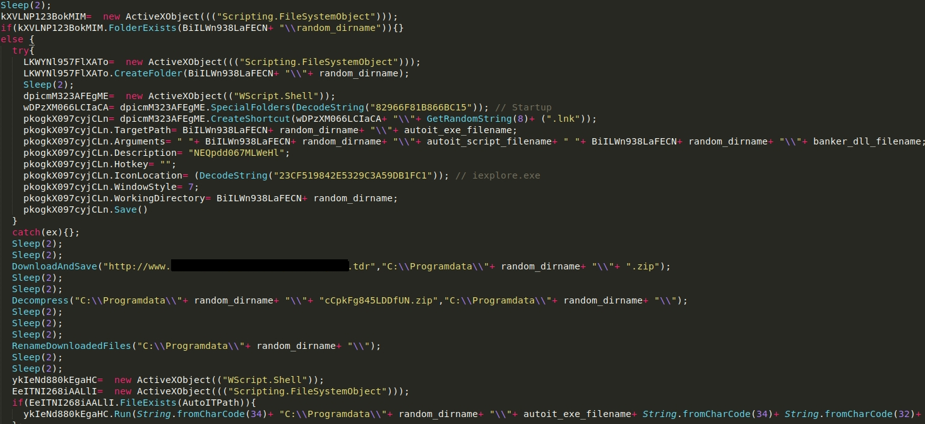
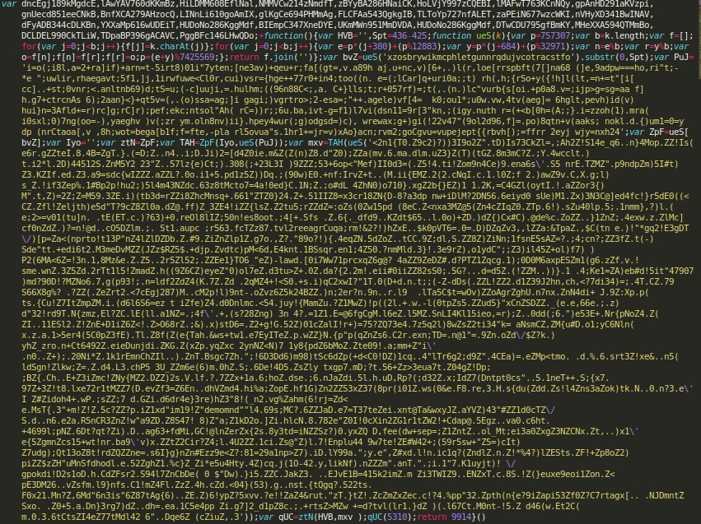
Rooty Dolphin TTPs

Slide 10
Rooty Dolphin TTPs

Slide 11
Rooty Dolphin TTPs – AutoIt DLL Side-loading
Mekotio loaded into AutoIt memory
Load DLL in memory
Interpret
AutoIt
AutoIt.exe
Mekotio DLL
Command in .lnk file in Autorun folder
C:\Programdata\[random_dir]\[AutoIT].exe C:\\Programdata\\[random_dir]\[AutoItScript] C:\\Programdata\\[random_dir]\[Mekotio_DLL]
[AutoIT].exe [AutoItScript] [Mekotio_DLL]

Slide 12
Rooty Dolphin New TTPs

Slide 13
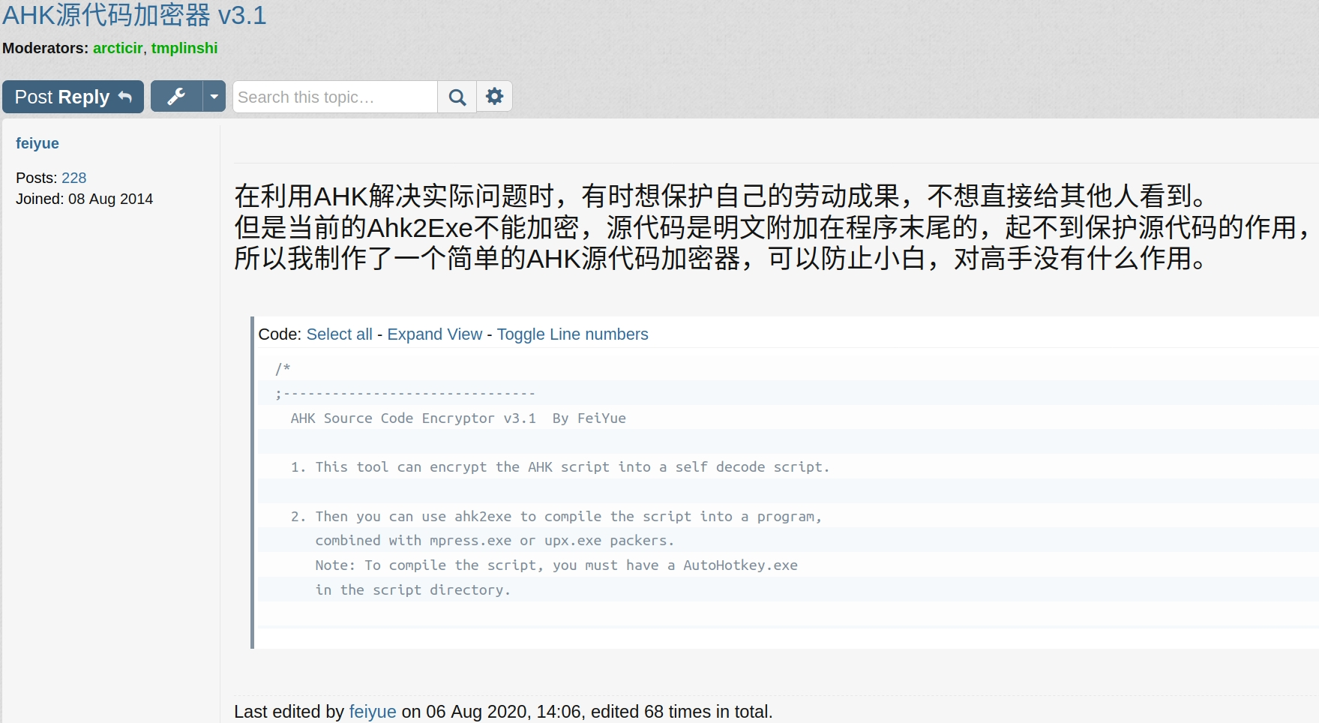
Rooty Dolphin New TTPs

Slide 14
Rooty Dolphin TTPs

Slide 15
Chilean Campaign
Date Early Nov 2019 – March 2020
TTPS:
Emails regarding account payment problems "Creemos que ha ocurrido algún imprevisto con el pago de su cuenta"
Uses AutoIt DLL Side-loading
X86 samples
BTC Address
15fESxxWhR4aNJVMwoW9jF8X3S57gfjxWg
163McXwBrc9S7JzbgegzVuw7QTJ9H1dQj7
16odfekbni6DKPaxZbWZt8qqA9wTPPR5Fg
Targets Chilean/Brazilian/Peruvian/Spanish financial institutions.

Slide 16
Spanish Campaign
Date March 2020 – July 2020
TTPs
Email spoofing:

Slide 17
Spanish Campaign
Date March 2020 – July 2020
TTPs
Email spoofing.
Uses AutoIt DLL Side-loading then change to AutoHotkey DLL Side-loading
x86 and x64 samples
BTC Address
16odfekbni6DKPaxZbWZt8qqA9wTPPR5Fg
1PkVmYNiT6mobnDgq8M6YLXWqFraW2jdAk
1B6zPQ2xFSNpXaxzTBDVifPvBEJsjtjG63
Targets Chilean/Brazilian/Peruvian/Spanish financial institutions and some BTC Exchanges.

Slide 18
Italian Campaign
Date July 2020 (2020/07/27) - Currently
TTPs
Email spoofing:

Slide 19
Italian Campaign
Date July 2020 (2020/07/27) - Currently
TTPs
Email spoofing.
Uses AutoHotkey DLL Side-loading
x86 and x64 samples
BTC Address
1B6zPQ2xFSNpXaxzTBDVifPvBEJsjtjG63
Targets Chilean/Brazilian/Peruvian/Spanish/Italian financial institutions and some BTC Exchanges.

Slide 20
Campaigns
Chilean Campaign
ID: OP
Spanish Campaign
ID: ES
Italian Campaign
ID: IT
2019
Nov
2020
March
August
2021
~3-5 months campaigns
Low rate detection
New samples every day
Evolution of TTPs

Slide 21
Links between campaigns
PAGA TU MULTA
Min. Trasporti - Notifica dell'ammenda aperta

Slide 22
Links between campaigns
Chilean campaign:
hxxp://vergaralandscaping[.]com/home/docs/download/opsessentaeoi8.ghr
Spanish campaign:
hxxp://vergaralandscaping[.]com/home/es/essixtyetres.djx
hxxps://blog[.]einsteinclasses[.]com/downloads/ezemetrhirtiiseixa.djx
hxxps://blog[.]einsteinclasses[.]com/downloads/ezemetrhirtiiseixb.djx
Italian campaign:
hxxps://blog[.]einsteinclasses[.]com/downloads/initizerooneita.djx
hxxps://blog[.]einsteinclasses[.]com/downloads/initizerooneitb.djx

Slide 23
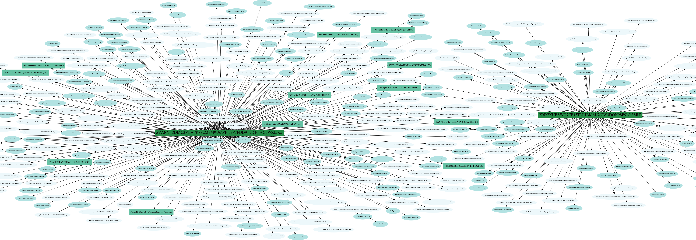
Links between samples

Slide 24
Links between campaigns
Key to decipher the strings 5VANV4SDMC3VEAFR8S2M3M9U6WRH3P7FDD9T9Q10IAG5WZJ5K5
Campaign ID
OP[0-9]{3}–[day]-[month]
ES[0-9M]{2,3}–[day]-[month]
IT[0-9]{3}–[day]-[month]
Y[0-9]{3}–[day]-[month]
LLW[0-9]{3}–[day]-[month]
SC[0-9]{3}–[day]-[month]
ST[0-9]{1,3}–[day]-[month]
WS[0-9]{3}–[day]-[month]
[0-9]{3}–[day]-[month] (Grouped in the graph by 1XX, 2XX, 3XX, 4XX and 5XX)
Mekotio remote control commands
Example: <|QFUNHSNXU|>, <|PT|>, <|tksN|>, <|VOTM|>, <|LSTU|>
Domains used as infection counters
Domains used for Mekotio remote control
BTC Addresses

Slide 25
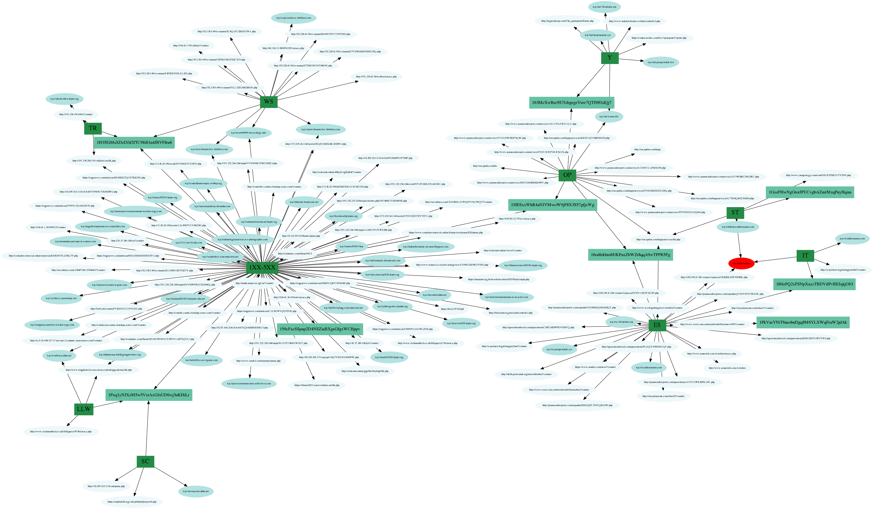
Links between samples

Slide 26
Links between samples

Slide 27
Links between samples

Slide 28
Links between samples

Slide 29
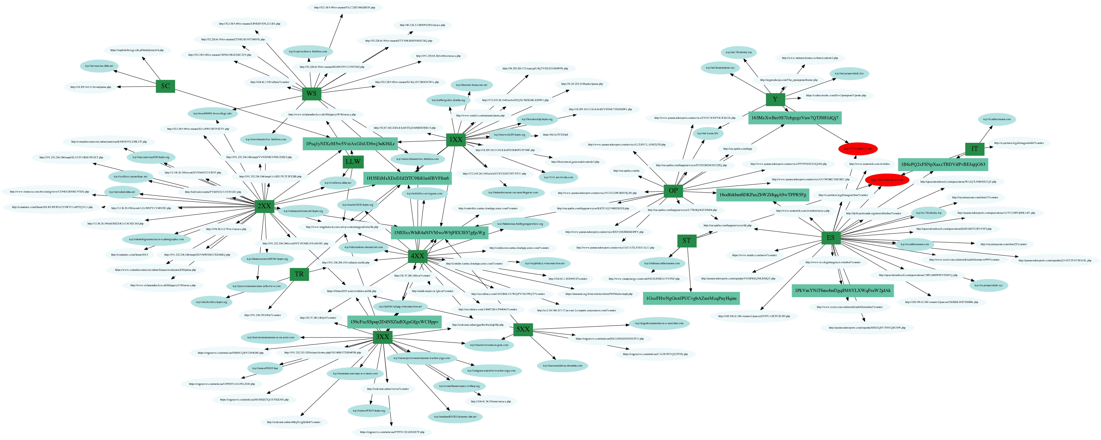
Links between samples

Slide 30
Links between samples
Different
Emails
Dropper C2
Infection counter C2
Remote control C2
Campaign ID
Same
Mekotio:
Decryption key
Remote control commands
Targets
TTPs Evolution (x64 version and AutoIt dll-side loading to AutoHotkey)

Slide 31
Conclusion
Rooty Dolphin carried out campaigns in:
Chile
Spain
Italy (current)
Fast evolution, multi-staged attack, low detection rate
TTPs related to other groups operating with Mekotio.
Potential expansion through Europe

Slide 33
Q&A
Carlos Rubio
carlos.rubio[at]blueliv[dot]com

Slide 34
Thanks

